Slide 1
USE OF STEEL TARGETS
Orientation and Test
Target Types
Locations
Minimum Distances
Procedures

Slide 2
Target Types
Only hardened steel targets intended for shooting can be used.
Manufacture’s guidelines will be followed regarding proper caliber and distance.
NO mild steel that can be dented or penetrated by shooting.
Any shape or size of flat steel is allowed provided it is manufactured for shooting and in good condition. Meaning flat with no excessive concave or dimpling/pitting of the impact surface.

Slide 3
Locations
Tactical/Pistol Bays
Use: Proper steel targets can only be used with pistols, pistol caliber carbines and Shotguns in the Tactical bays. Location and position: see note below.
Rifle Range
Use: Proper steel targets can only be used with rifles and pistol caliber carbines at the rifle range at proper distances.
Covered Pistol Areas
No Steel targets can be used in the covered pistol shooting areas.

Slide 4
NO STEEL in RED Areas

Slide 5
Minimum Distances
Pistol calibers minimum distance is 7 yards or manufacture’s guidance.
Rifle calibers minimum distance is 100 yards and allow for manufacture’s velocity limit. Max bullet velocity at the target is generally 2850 Feet Per Second.
Shotgun, bird or buck shot (lead only) - minimum distance is 10 yards.
Shotgun slugs - minimum distance is 100 yards.

Slide 6
Procedures
Targets will be positioned close to the berm in a manner that allows missed shots to impact the berm and not ricochet off the ground.
Steel targets will be mounted on an angle or swivel to help direct splatter downward (15 degrees is best).
Steel targets will be positioned to prevent splatter from damaging anything around them.
If using multiple steel targets, ensure that targets are outside the splatter zone of other targets.
Strongly recommend long sleeve shirts and long pants for all shooters and personnel on the range where steel targets are being used to reduce potential injury from lead and jacket particles.

Slide 7
Procedures
ALWAYS, wear eye protection, shooters and non-shooter!
ALWAYS inspect the target for damage, functionality, stability, etc., before using.
ALWAYS place the target over a soft surface free of large rocks or other secondary ricochet hazards.
ALWAYS stand at least 7 yards from the target when using pistol calibers.
ALWAYS stand at least 100 yards from the target when using rifle calibers.

Slide 8
Procedures
NEVER shoot BB's, steel shot, or air gun pellets at steel targets.
NEVER shoot on steel that is excessively cratered, pitted, or damaged in any way.
NEVER exceed a 20-degree angle of engagement.
NEVER use ammo with steel in it or on it.
NEVER use ammo that travels slower than 400ft/sec.

Slide 9
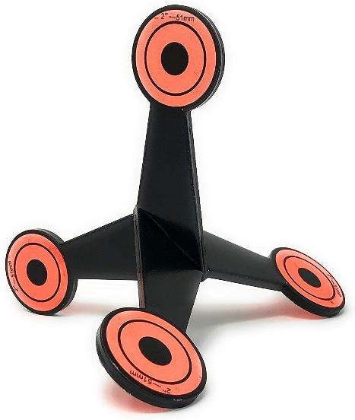
Do not use!
This type of steel targe is for ground use and will cause ricochets!
There is no control of where the bullet splatter will go!

Slide 10
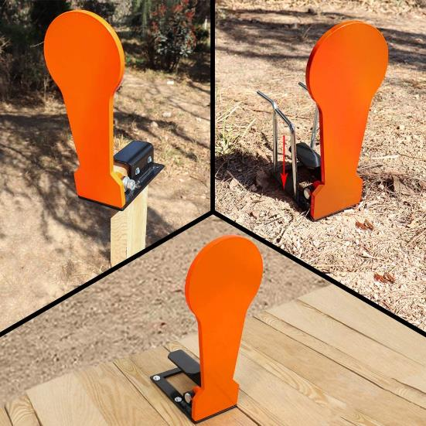
MUST be placed at the berm base
This may also be elevated to allow missed shots to impact the berm.
If placed on the ground away from the berm, it can also cause ricochets!

Slide 11
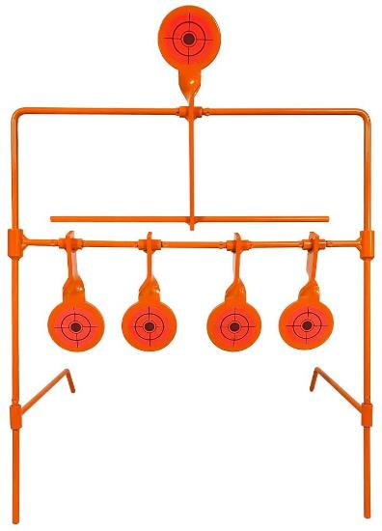
MUST be placed at the berm base
This may also be elevated to allow missed shots to impact the berm.
If placed on the ground away from the berm, it can also cause ricochets!

Slide 12
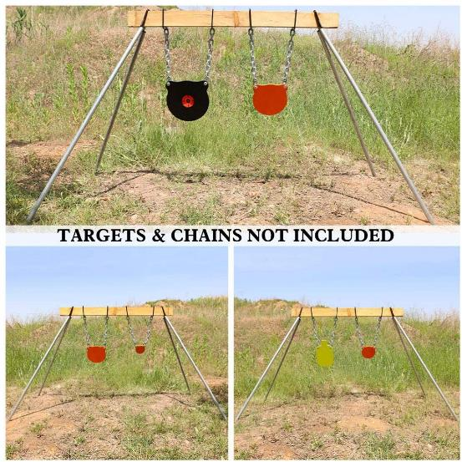
Good elevated targets
Keep properly placed so missed rounds will impact the berm, NOT the ground.

Slide 13
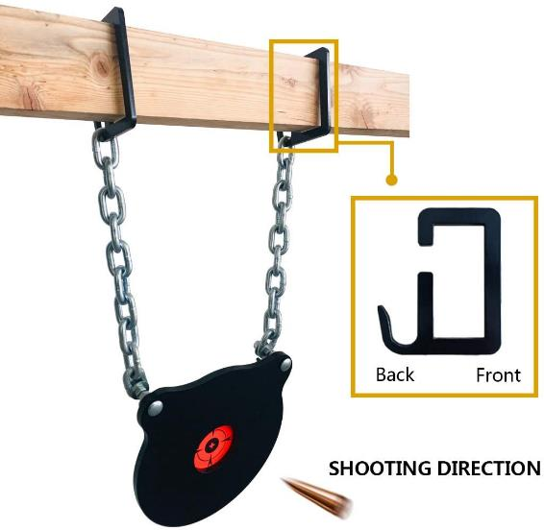
Properly angled target
Chains are offset from the target to help direct bullet fragments towards the ground.

Slide 14
Targets Properly Placed at Base of Berm

Slide 15
Look at target placement. Which one is not good?

Slide 16
Good Placement

Slide 17
Good Placement

Slide 18
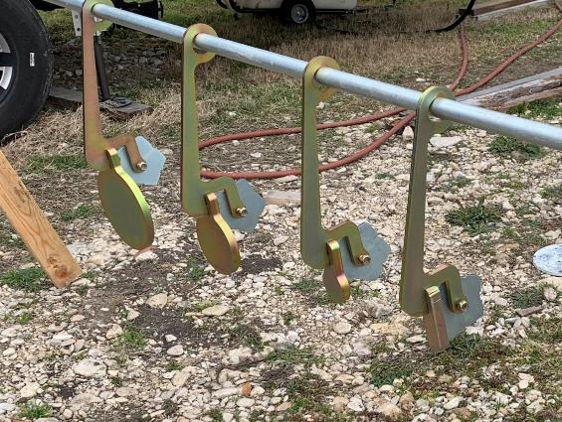
Target Hangers

Slide 19
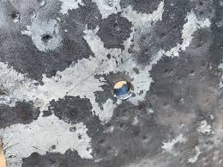
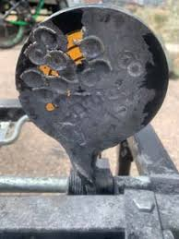
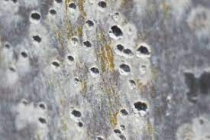
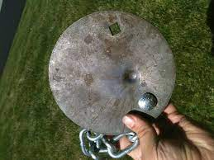
Damaged Targets
These targets have been abused and are considered excessively damaged.

Slide 20
Questions?

